Slide 1
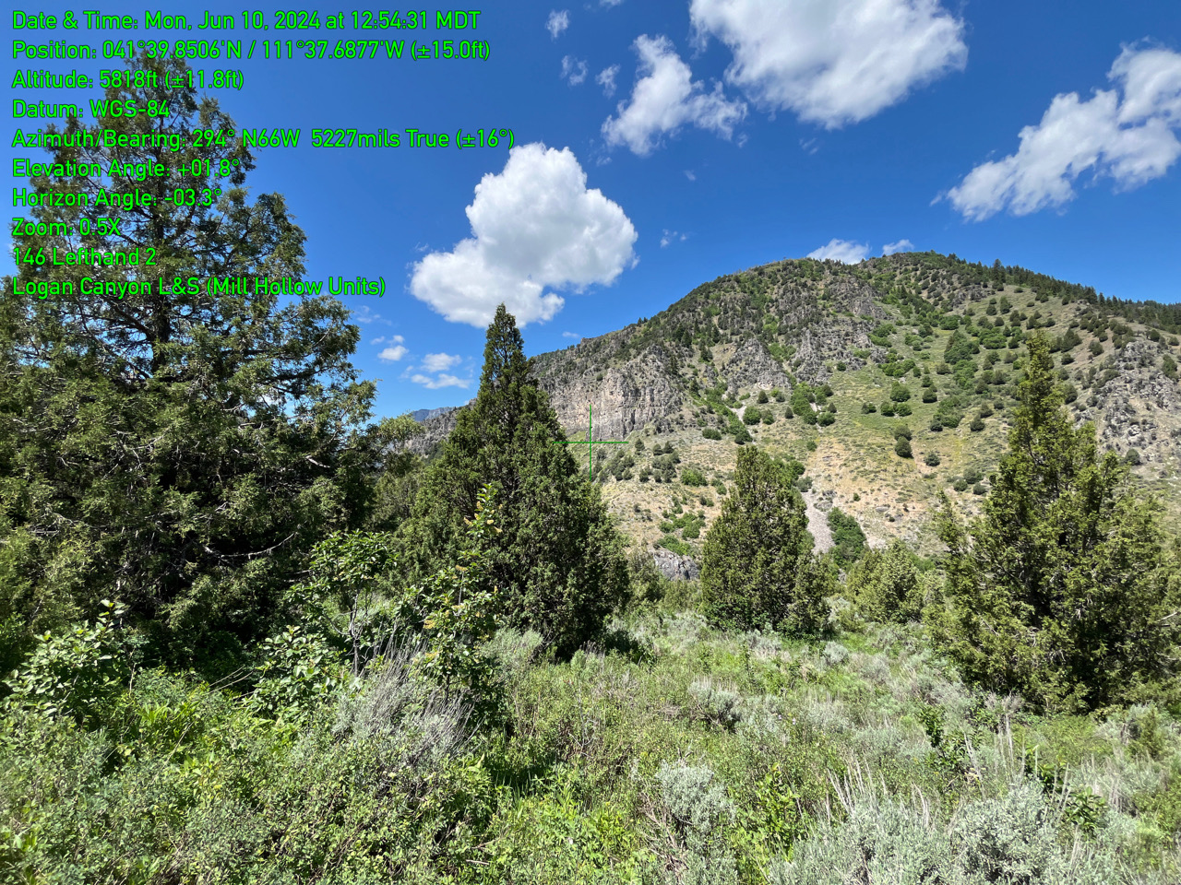
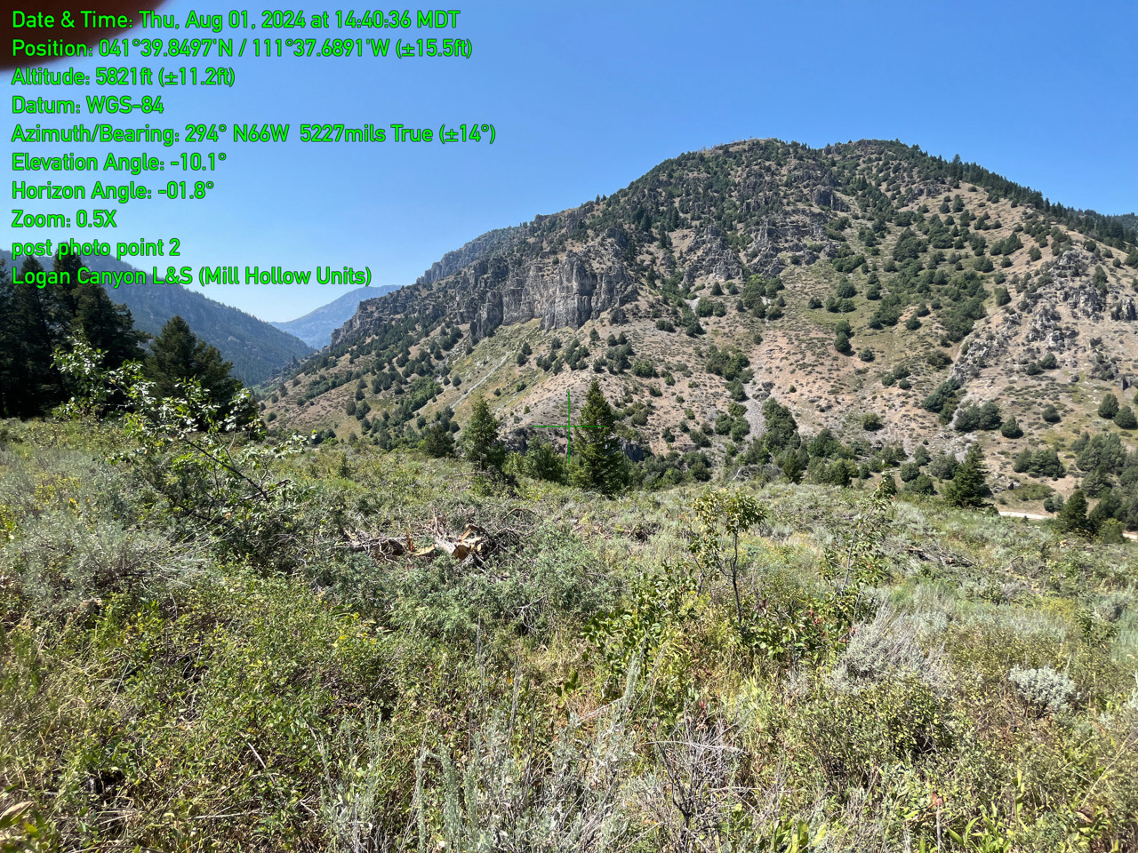
Logan Juniper Lop/Scatter
Pre-treatment
Post-treatment

Slide 2
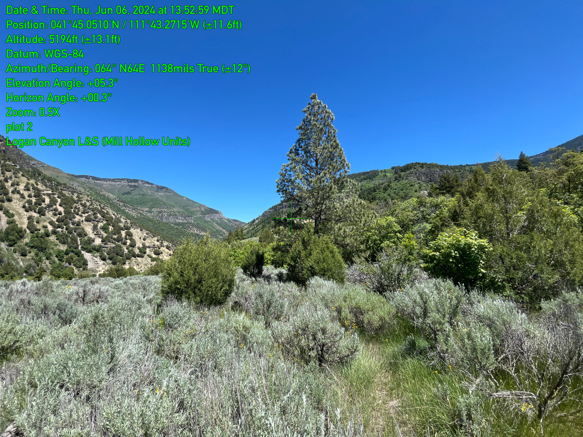
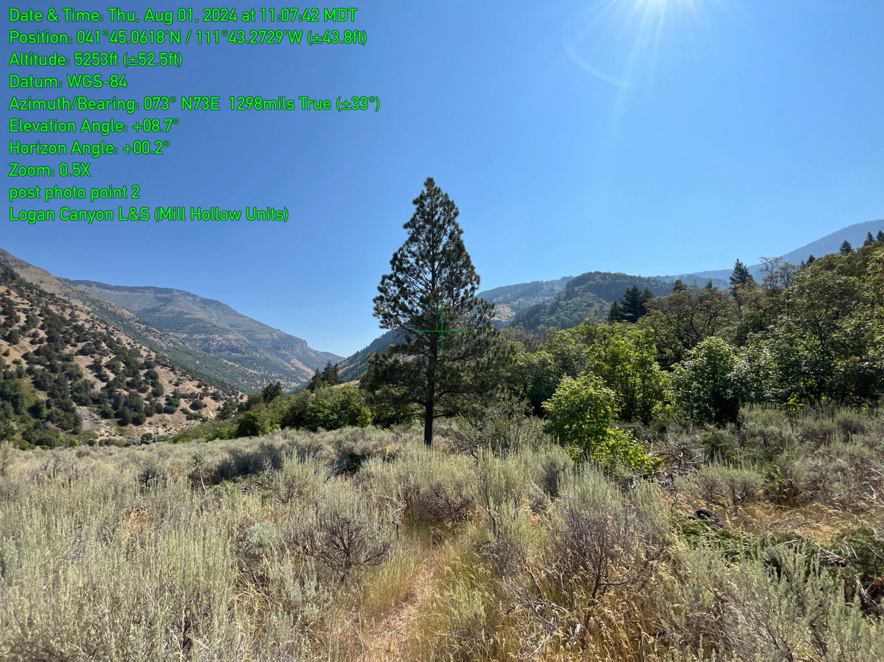
Logan Juniper Lop/Scatter
Pre-treatment
Post-treatment

Slide 3
Logan Juniper Lop/Scatter
Pre-treatment
Post-treatment

